Slide 1
RECOMMENDER SYSTEMS OVERVIEW
NAME: L.S.V.S.Ramakrishna DATE: 10 - NOV- 2024

Slide 2
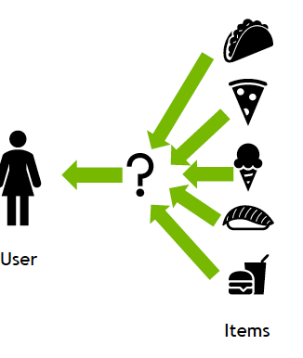
WHAT ARE RECOMMENDER SYSTEMS?
DEFINITION AND FUNCTIONALITY
Recommender systems are algorithms designed to suggest products, services, or information to users based on various data sources. They enhance user experience by personalizing suggestions.

Slide 3
TYPES OF RECOMMENDER SYSTEMS

Slide 4
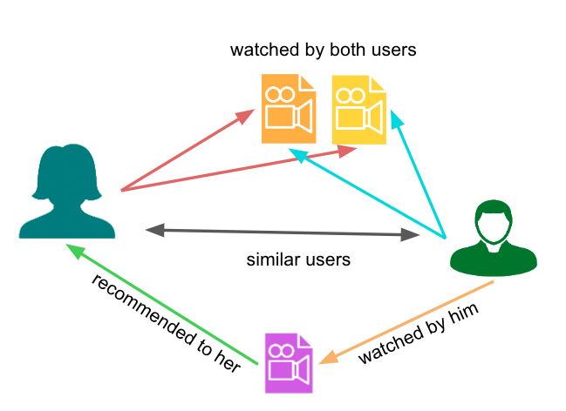
COLLABORATIVE FILTERING EXPLAINED
BENEFITS AND CHALLENGES
This method provides personalized experiences but can face challenges like cold start problems, where new users lack data for effective recommendations.
HOW IT WORKS
Collaborative filtering relies on user interactions and preferences. The algorithm analyzes behaviors of similar users to recommend items based on historical data. assuming that people often like items that others with similar tastes also like.

Slide 5
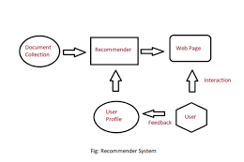
CONTENT-BASED FILTERING
ADVANTAGES AND LIMITATIONS
This approach ensures relevance by focusing on specifics, but it risks over-specialization, limiting exposure to diverse recommendations.
MECHANISM OF ACTION
Content-based filtering suggests items based on their features and the users' past preferences. It assesses item characteristics relevant to users.

Slide 6
COMPARISON TABLE
This table summarizes key differences between collaborative and content-based filtering. It highlights aspects like data dependency and personalization.
ASPECT | COLLABORATIVE FILTERING | CONTENT-BASED FILTERING
Data Dependency | User interaction data | Item features
Personalization | User similarity | User's past preferences
Cold Start Issue | Yes, for new users | No, more efficient
Diversity | Limited by user base | High, as items are based on content

Slide 7
EXAMPLES OF SYSTEMS
E-COMMERCE PLATFORMS
STREAMING SERVICES
SOCIAL MEDIA
Amazon utilizes both filtering methods, using user purchase history for recommendations and item features to suggest similar products.
Netflix combines collaborative and content-based filtering to suggest shows based on user viewing habits and content characteristics.
Facebook employs these systems to recommend friends, groups, and content based on user interactions and interests.

Slide 8

NUMERICAL EXAMPLE ON CONTENT BASED FILTERING

Slide 9


Slide 10

CONCLUSION AND FUTURE TRENDS
SUMMARY AND OUTLOOK
collaborative filtering is a powerful recommendation technique that enhances user experience by providing personalized, diverse, and relevant recommendations based on patterns in user behavior. By leveraging similarities in user preferences or item interactions, collaborative filtering effectively recommends items without needing extensive item metadata or domain knowledge. It’s particularly useful in domains with complex items like movies, music, or books, where recommendations rely on subjective preferences.

